Slide 1
Measures and metrics
Pattern Recognition 2015/2016
Marc van Kreveld

Slide 2
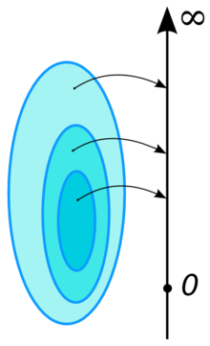
Measures in mathematics
Functions from “subsets” to the reals
A measure obeys the properties:
Non-negativeness: for any subset X, f(X) ≥ 0
Null empty set: For the empty set, f(∅) = 0
Additivity: for two disjoint subsets X and Y, f(X ∪ Y) = f(X) + f(Y)

Slide 3
Measures in mathematics
Example 1: Space is the real line, subsets are disjoint unions intervals, measure is (total) length
Example 2: Space is all integers, subsets are subsets of integers, measure is number of integers in a subset
Example 3: Space is outcomes of an experiment (die rolling), measure is probability of the outcome(s)

Slide 4
Measures in the rest of science
Functions from “something” to the nonnegative reals
Capture an intuitive aspect: size, quality, difficulty, distance, similarity, usefulness, robustness, …
Precision and recall in information retrieval
Support and confidence in association rule mining

Slide 5
Distance functions, or metrics
Distance: how far things are apart
A metric or distance function takes two arguments and returns a nonnegative real
Distances on a set X; for any x,y,z in X, a metric is a function d(x,y) → R (the reals) where:
d(x,y) ≥ 0 non-negative
d(x,y) = 0 if and only if x = y coincidence
d(x,y) = d(y,x) symmetry
d(x,z) ≤ d(x,y) + d(y,z) triangle inequality

Slide 6





Examples of metrics on points
Euclidean distance on the line, in the plane or in a higher-dimensional space
Squared Euclidean distance in these cases
City block, Manhattan, or L₁ distance
$$\sqrt{{∆x}^{2}+∆y^{2}}$$
$${∆x}^{2}+∆y^{2}$$
$$∆x+∆y$$
$$∆y$$
$$∆x$$
not a metric!

Slide 7
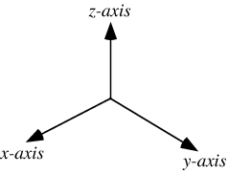
Distances between points in an attribute space?
Suppose points in 3D represent people with their age, weight, and length
Any metric that uses these components is influenced by normalization or scaling of an axis
Any metric makes a choice on how many years correspond to one kilo or one centimeter, and therefore weighs the relevance of the components
length
1 cm
1 year
1 kilo
age
weight

Slide 8
Distances between points in an attribute space?
For a specific point set in an attribute space, one can normalize its axes by making the unit the standard deviation of its values
… but then, two different point sets in spaces with the same attributes use different distances
length
1 cm
1 year
1 kilo
age
weight

Slide 9
Example of metric on polygons
Area of symmetric difference Asym, is it a metric?
Three properties (nonnegative, coincidence, symmetry) clear, to be verified: triangle inequality. It reads: Given three polygons P, Q, R, we always have Asym(P,Q) ≤ Asym(P,R) + Asym (R,Q)
P
Q

Slide 10
Example of metric on polygons
Given three polygons P, Q, R, we always have Asym(P,Q) ≤ Asym(P,R) + Asym (R,Q)
For polygon R,
anything R contains of P but not Q makes Asym(R,Q) larger by that area
anything R contains of Q but not P, same argument
anything R contains of both P and Q does not give area to Asym(P,Q)
anything R contains outside P and Q does not add to Asym(P,Q)
P
Q
Notes:
So, the triangle inequality holds, and area of symmetric difference is a metric

Slide 11
Interesting aspects for measures in geometric pattern matching
“Measures” in the loose sense
Size (descriptive measure for many things)
Elongatedness (descriptive measure for a polygon)
Spread (descriptive measure for a point set)
Goodness of fit (for e.g. a shape and a point set)
Similarity / distance (for two things of the same type)
…

Slide 12
Aggregation in measures
When defining the distance between two point sets, we may want to combine several point-point distances into one distance measure
This can be called aggregation of distances

Slide 13
Aggregation in measures
Bottleneck: aggregation is done by taking a minimum or maximum over values Examples: Hausdorff, Fréchet
Sum: aggregation is done by taking the sum over values Examples: DTW, EMD, area of symmetric difference
Sum-of-squares: aggregation is done by taking the sum-of-squares over values Example: Error of regression line model

Slide 14
Aggregation in measures
Bottleneck: sensitive to outliers
Sum: mildly sensitive to outliers
Sum-of-squares: moderately sensitive to outliers

Slide 15
Well-known measures
Hausdorff distance (any set; asymmetric, symmetric)
Area of symmetric difference (for polygons)
Fréchet distance (for curves)
Dynamic Time Warping (for time series, or for curves)
Earth Mover’s Distance

Slide 16
Hausdorff distance
Defined for any two subsets of the plane (two point sets, two curves, two polygons, a curve and a polygon, …)
A
B
A
B

Slide 17
Hausdorff distance
Defined for any two subsets of the plane (two point sets, two curves, two polygons, a curve and a polygon, …)
Bottleneck metric
Asymmetric version: A → B (or B → A); not a metric
Symmetric version: Max of both asymmetric versions:
Max ( max min dist(a,b) , max min dist(b,a) )
a∈A
b∈B
b∈B
a∈A
A → B
B → A

Slide 18
Hausdorff distance
Which is larger: the Hausdorff distance A → B or B → A ?
A
B

Slide 19
Hausdorff distance
Which is larger: the Hausdorff distance A → B or B → A ?
A
B

Slide 20
Computation Hausdorff distance
Where can largest distance from A to B occur?
A
A
B
B
Vertex of A
Point internal to edge of A
⇓
In this case, the minimum distance must be attained from that point on A to two places on B

Slide 21
Computation Hausdorff distance
Vertex of A that minimizes distance to B: - Compute Voronoi diagram of edges of B - Preprocess for planar point location - Query with every vertex of A to find the closest point to B and the distance to it
A
|A| = n
O(m log m + n log m) time
B
|B| = m
Vertex of A

Slide 22
Computation Hausdorff distance
Point internal to
edge of A
A
Smallest distance to B attained at two places
B
Compute Voronoi diagram of the edges of B
Compute intersection points of the edges of A with the Voronoi edges of B
Compute intersection point on A with maximum smallest distance to B

Slide 23
Computation Hausdorff distance
Worst case: Θ(nm) intersection points between A and the Voronoi diagram of B, then O(nm log (nm)) time
Typical: O(n+m) intersection points, then the algorithm takes O((n+m) log (n+m)) time
Inclusive of distance B to A and taking maximum: O((n+m) log (n+m)) time

Slide 24
Computation area of symmetric difference
Perform map overlay (Boolean operation) on the two polygons
Compute area of symmetric difference of the polygons and add up

Slide 25
Computation area of symmetric difference
Perform map overlay (Boolean operation) on the two polygons
Compute area of symmetric difference of the polygons and add up
Worst case: O(nm log (nm)) time
Typical case: O((n+m) log (n+m)) time

Slide 26
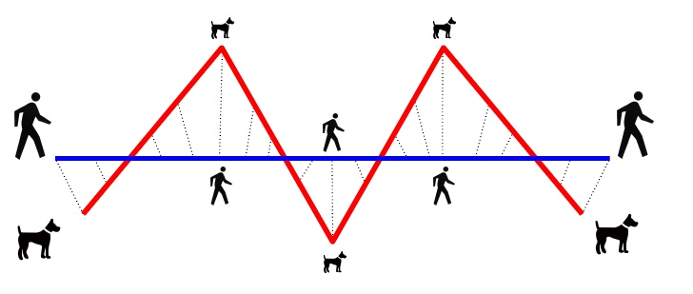
Fréchet distance
For two oriented curves in 2D or 3D
Extensions to surfaces exist (but are not treated)
Intuitively: a man walks on one curve with irregular speeds, but only forward, and a dog does the same on the other curve. The Fréchet distance is the minimum leash length needed to allow this (man-dog distance, leash distance)

Slide 27
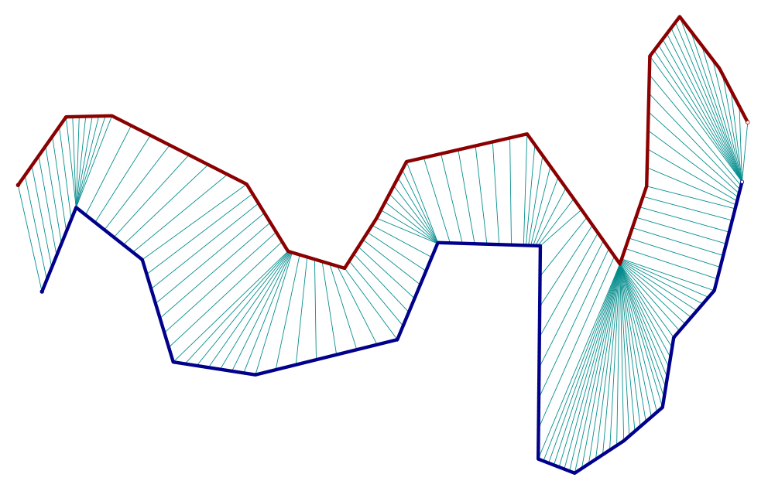
Fréchet distance
Needed: the relative parametrizations over the two curves

Slide 28
Fréchet distance
Definition: let α : [0,1] be a parametrization of curve A and let β : [0,1] be a parametrization of curve B where
α(0) = the start of A
α(1) = the end of A
β(0) = the start of B
β(1) = the end of B
α is a continuous bijection between [0,1] and A, and β is a continuous bijection between [0,1] and B

Slide 29
Fréchet distance
Definition: inf ( max dist(α(t), β(t)) )
Choosing α, β is choosing the relative “speeds”
Bottleneck distance due to the max over t
The Fréchet distance is never smaller than the Hausdorff distance; often they are the same
α, β
t ∈ [0,1]

Slide 30
Fréchet distance
When are the Fréchet distance and Hausdorff distance clearly different?

Slide 31
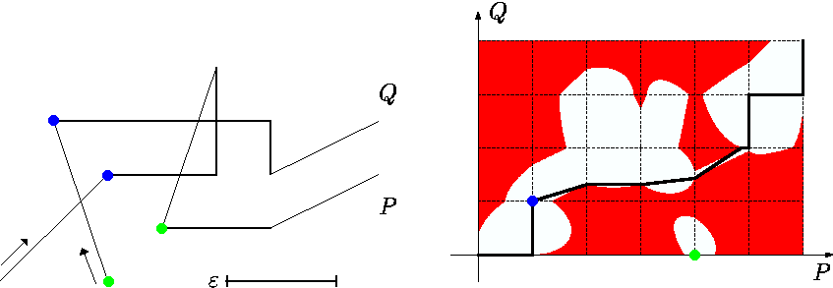
Fréchet distance
Computation using the free-space diagram
free-space diagram to decide whether the Fréchet distance is at most ε

Slide 32
Fréchet distance
Computation using the free-space diagram
The free-space diagram of two polylines with n and m edges can be built in O(nm) time
Existence of an xy-monotone path in the free space can be decided in O(nm log nm) time

Slide 33
Fréchet distance
The discrete Fréchet distance is like the Fréchet distance but only between vertices
Vertices must be visited in the right order
The discrete Fréchet distance is never larger than the normal Fréchet distance
The discrete Fréchet distance can be computed in O(nm) time by standard dynamic programming
Notes:
The example shows that the discrete Frechet distance can be much larger than the Frechet distance.

Slide 34
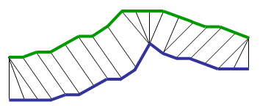
Dynamic Time Warping
Popular distance measure in time series analysis
Uses summed distances, not a bottleneck distance
Uses only distances between vertices
A[1],…, A[n]
B[1],…, B[m]
DTW(A[i..n], B[j..n]) = min
dist(A[i],B[j]) + DTW(A[i+1..n], B[j+1..m])
dist(A[i],B[j]) + DTW(A[i..n], B[j+1..m])
dist(A[i],B[j]) + DTW(A[i+1..n], B[j..m])

Slide 35
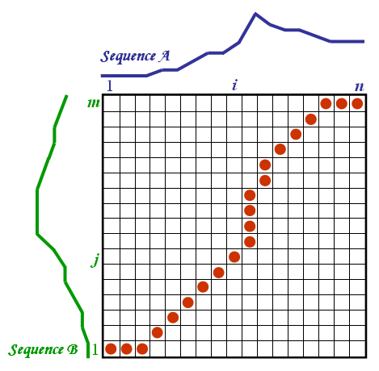
Dynamic Time Warping
Computable in O(nm) time by dynamic programming
Matrix M with dist(A[i], B[j]) in entry M[i,j]
The DTW distance is the cost of the cheapest path

Slide 36
Dynamic Time Warping
DTW distance is not a metric: it does not satisfy the triangle inequality
1/3
1/3
1/3
DTW(blue, red) ≈ 5/3
DTW(blue, green) ≈ 1/3
DTW(green, red) ≈ 1/3
DTW(blue, red) > DTW(blue, green) + DTW(green, red)

Slide 37
Earth Mover’s Distance
Metric for distance between two weighted point sets with the same total weight
Captures the minimum amount of energy needed to transport the weight from the one set to the other, where energy = weight x distance
1
3
2
1
1
1
1

Slide 38
Earth Mover’s Distance
Metric for distance between two weighted point sets with the same total weight
Captures the minimum amount of energy needed to transport the weight from the one set to the other, where energy = weight times distance
1
3
2
1 + 1 + 2x½ + √1¼
= 3 + √ 1¼ = 4.12
1
1
1
1

Slide 39
Earth Mover’s Distance
Metric for distance between two weighted point sets with the same total weight
Captures the minimum amount of energy needed to transport the weight from the one set to the other, where energy = weight times distance
1
3
2
1 + ½ + 2x½ + √2
= 2 ½ + √2 = 3.91
1
1
1
1

Slide 40
Earth Mover’s Distance
Also known as the Wasserstein metric
Computable in O(n³) time when there are n points, using a solution to the assignment problem (Hungarian algorithm)

Slide 41
Outliers and measures
Outliers can influence bottleneck measures significantly, but also sum-of-squares measures and (less so) sum measures
Hausdorff
distance
Hausdorff
distance
Notes:
According to the Hausdorff distance, the right point sets are more alike than the left point sets, due to one outlier

Slide 42
Outliers and measures
Solutions include:
Removing outliers in preprocessing
Redefining the measure to not include a small subset of the data
Using a different aggregation like sum-of-square-roots, when sum is considered too sensitive to outliers

Slide 43
Designing measures
A balance between simplicity and expressiveness

Slide 44
Designing measures
Example 1: Given a set of red points R and a set of blue points B, design a measure (score) that captures for any curve C, that C is close to R and not close to B
C₁ should get a higher value in the measure than C₂
C₁
C₂

Slide 45
Designing measures
Possibility 1: Percentage of the length of C that is closer to R than to B, based on closest point
100
72
C₁
C₂

Slide 46
Designing measures
Possibility 1: Percentage of the length of C that is closer to R than to B, based on closest point
Does not capture closeness itself; a curve twice as far may still get a score of 100
100
100
72
C₁
C₃
C₂

Slide 47
Designing measures
Possibility 1: Percentage of the length of C that is closer to R than to B, based on closest point
Does not capture closeness itself; a curve twice as far may still get a score of 100
Not “robust”: a small movement of the curve can change its score from 0 to 100
When there are no blue points, any curve gets score 100 (so it does not capture that C is close to R)
0
100

Slide 48
Designing measures
Possibility 2: Average (over the curve length) of the distance to the nearest blue point – distance to the nearest red point
C

Slide 49
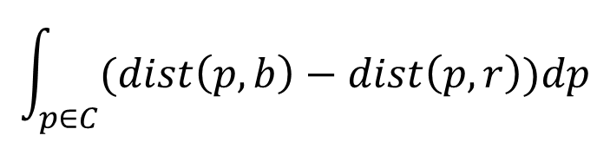

Designing measures
Possibility 2: Average (over the curve length) of the distance to the nearest blue point – distance to the nearest red point
$$\int_{p∈C}{(dist\left(p,b\right)−dist\left(p,r\right))dp}$$
$$\left\|C\right\|$$
C

Slide 50
Designing measures
Possibility 2: Average (over the curve length) of the distance to the nearest blue point – distance to the nearest red point
Robust
Not scale-invariant
Does not capture closeness to R, only relative to B
Does not work when there are no blue points
nearly same score

Slide 51
Designing measures
Example 2: Given a set of red points R and a set of blue points B, design a distance measure for them
Immediate question: Are R and B samples from a region, and we are really interested in how much these regions are alike, or are R and B really point data (e.g. locations of burglaries and car break-ins)?
In the first case these point sets are very similar, in the second case they are not

Slide 52
Designing measures
In the first case: reconstruct the regions (e.g. by alpha-shapes) and use area of symmetric difference
Alternatively, use the Hausdorff distance
In the second case: equalize the weights by making the points in the smaller set heavier than 1, and use the Earth Mover’s Distance

Slide 53
Combining measures
Suppose we have a measure in [0,1] for elongatedness of a shape and another one for frilliness, called E and F How can we combine these into a score for both elongatedness and frilliness?

Slide 54
Combining measures
Suppose we have a measure in [0,1] for elongatedness of a shape and another one for frilliness, called E and F How can we combine these into a score for both elongatedness and frilliness?
Weighted linear combination: α E + (1-α) F with α ∈ [0,1]

Slide 55
Combining measures
Suppose we have a measure in [0,1] for elongatedness of a shape and another one for frilliness, called E and F How can we combine these into a score for both elongatedness and frilliness?
Weighted linear combination: α E + (1-α) F with α ∈ [0,1]
Multiplication: E F

Slide 56
Combining measures
Suppose we have a measure in [0,1] for elongatedness of a shape and another one for frilliness, called E and F How can we combine these into a score for both elongatedness and frilliness?
Weighted linear combination: α E + (1-α) F with α ∈ [0,1]
Multiplication: E F
Weighted version: E ^{α} F ^{1-α} with α ∈ [0,1]

Slide 57
Combining measures
Suppose we have a measure in [0,1] for elongatedness of a shape and another one for frilliness, called E and F How can we combine these into a score for both elongatedness and frilliness?
elongated | frilly | combined WLC | combined Mult.
0 | 0 | 0 | 0
1 | 1 | 1 | 1
0 | 1 | 0.5 | 0
0.5 | 0.5 | 0.5 | 0.5
0.5 | 1 | 0.75 | 0.707
0.75 | 0.75 | 0.75 | 0.75
α = 0.5
α = 0.5

Slide 58
Summary
Measures and metrics are useful to have things to optimize and things to compare quantitatively
There are many established measures and metrics
Sometimes one has to define one’s own measure or metric for specific situations
Computation of measures requires geometric algorithms

